Slide 1
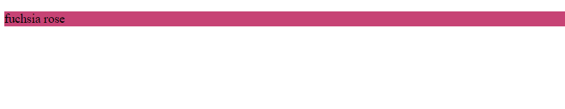
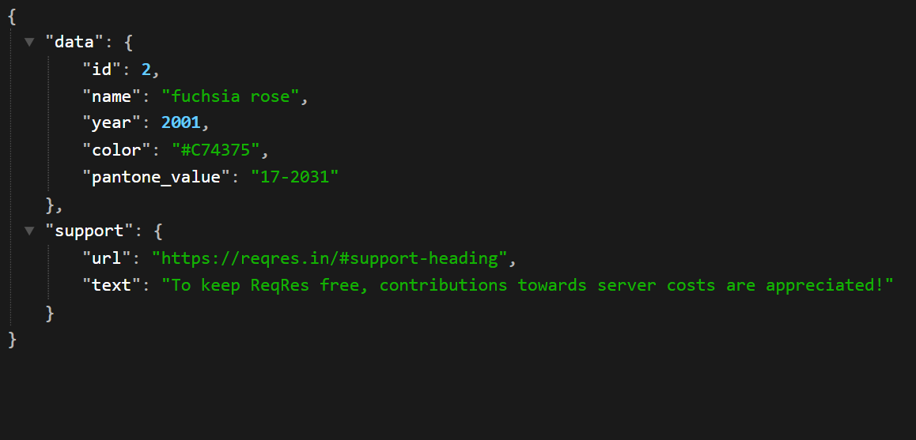
PRACTICE 01
Use AXIOS to fetch data from this URL: https://reqres.in/api/unknown/2
Display the name and set background color that get from this URL.
Expected result
Data

Slide 2
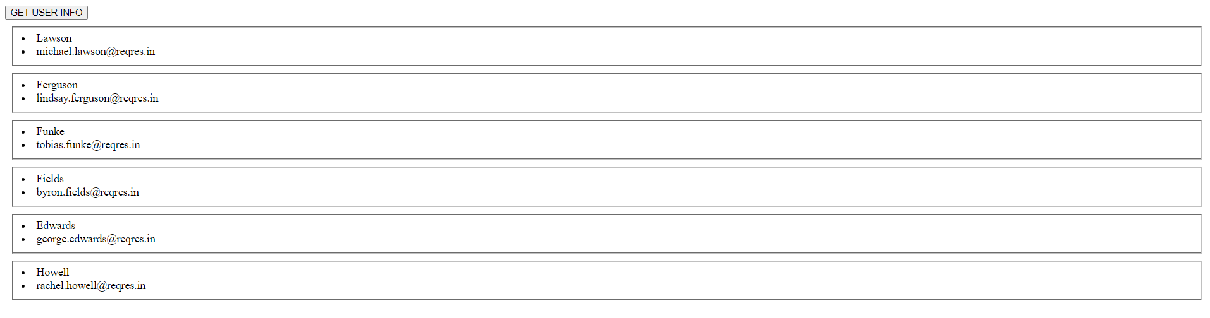
PRACTICE 02
Use AXIOS to fetch data from this URL: https://reqres.in/api/users?page=2
In HTML has a button “GET USER INFO”
When user click on the button display all of the information.
Expected result

Slide 3
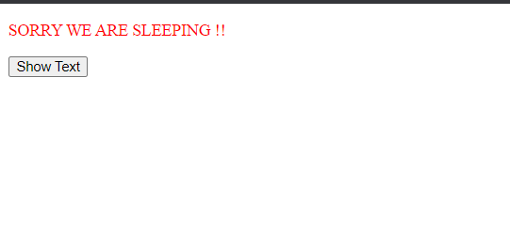
PRACTICE 03
Use AXIOS to fetch data from this URL: https://reqres.in/api/unknown/23
Create a function to send the message when Axios requested error.
Expected result

